Slide 1
INTRODECTION OF MYSELF
Presented by Priyanka Khatri

Slide 2
WHO I
AM
Myself Priyanka Khatri .
I am from Palanpur and currently living in Ahemadabad .
Currently I am persuing my Python course at TOPS Ahemdabad .
I am very calm, determined and hardworking person .

Slide 3
I enjoy listening to music in my leisure time .
I am a morning person.
I can manage my time.
I am very punctual in my life.
I always welcome new opportunities to be best of myself.
SWOT

Slide 4
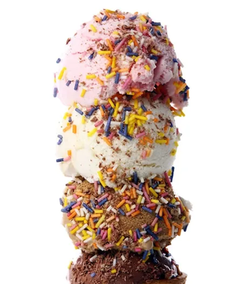
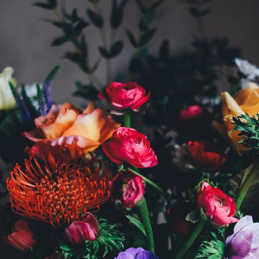
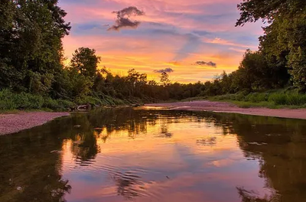
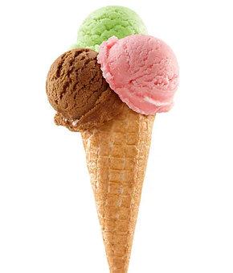
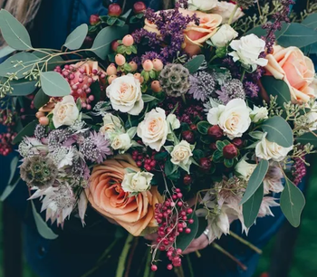
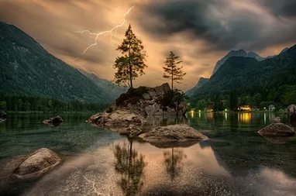
I LOVE . . .
I LIKE TO EAT ICECREAMS.
I AM ALSO LIKE FLOWERS.
I AM A NATURE LOVER.
ICE-CREAM
FLOWERS
NATURE

Slide 5

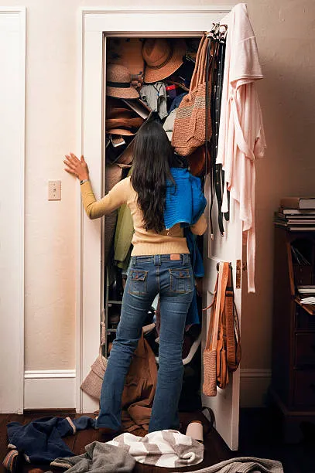
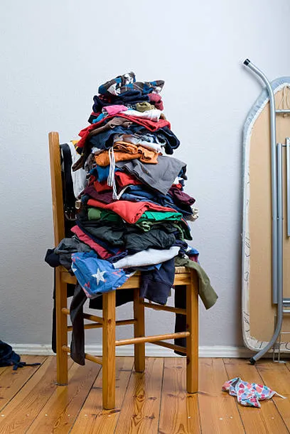
I HATE . . .
Messy Wardrobe
Dirty Cloths

Slide 6
BE BRAVE IN
LIFE AND
ACHIVE YOUR
GOALS ! ! !

Slide 7
Thank
you !

